Slide 1
4TH March 2015
WALT: We are learning to transform a text

Slide 2
Writing my response
What would I have done?

Slide 3
Planning our response
Describing the scene
What Bill Bryson actually did
What I would do

Slide 4
What Bryson actually did
8 steps ....
He shuffled on his knees. | Where?
He unzipped the mesh. | How?
He peered out.
He brought in his backpack. | How?
He searched for his knife.
He opened the blade.
He climbed out of the tent. | How?
He shone the torch into the darkness.

Slide 5
Bryson’s imperative
Arm himself with a weapon
Check the source of the danger

Slide 6
What Bryson might have done
Under the circumstances |  | action | effect
 | he could have
 | he might have
 | he may have
kept perfectly still
so that the animal might not hear him.
shouted loudly
to scare the animal away.
thrown a rock
to make the animal move in a different direction.

Slide 7
Decide on your imperative
What would you have done?
Fight or flight?

Slide 8
Imagine it was you in the tent ...
But this time you were alone…
Totally alone…..
It was the middle of the night….
The middle of nowhere…and
The middle of an unforgettable adventure

Slide 9
Decide on the 8 stages of your story
Set the scene – who/when/where
Introduce the 1st problem e.g. scary sound/strange smell/weird feeling (why)
2. Describe what you did in response? (how)
3. Did this make things improve/get worse? (why)
Introduce 2nd problem – much bigger? (what)
How did you respond this time round? Did it work?
6. Introduce 3rd problem which took you by surprise
Did you manage to overcome this? How?
What have you learned from this event – about yourself/the problem?

Slide 10
Add imagery
Sensory….
See
Hear
Feel/touch
Taste
Smell
Thermal … hot/cold
Visual … light/dark

Slide 11
Choose at least 3 words from each category to help you to describe what happened
Noun | Adjective | Verb | Adverb
forest | heavy | plodded | cautiously
fire | tranquil | whispered | instinctively
branches | sharp | blinked | frantically
undergrowth | vicious | searched | silently
creature | snuffling | shivered | distressingly
tent | tiny | died | quickly
eyes | huge | dashed | scarily

Slide 12
You can choose 2/3 items to help you – remember to use them in an unusual way
> | ? | > | ?
toothbrush | Nail glue | Fire extinguisher | whistle
Ipod | mintoes | blanket | rope
Rice Krispies | Pen-knife | bucket | teddy
compass | Hair straighteners | Glass bottle | Magnifying glass
tights | Space pen | newspaper | Bubble wrap
hairspray | matches | Mobile phone | A can of diet cola
Magnifying glass | shovel | sellotape | Paper clip

Slide 13
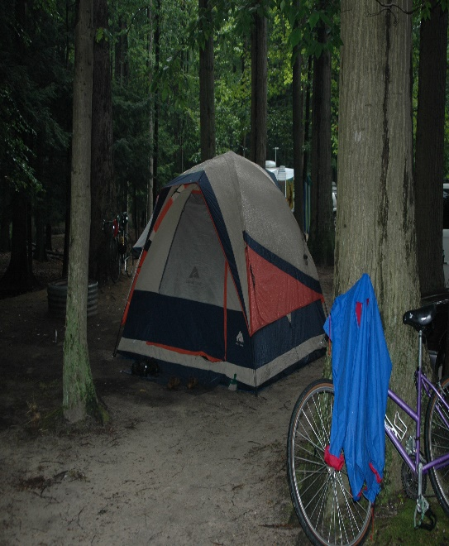
Draw a picture and write a caption for each stage of your story
I had gone camping alone. My friend had let me down. I thought it would be an adventure.

Slide 14
Put it all together and now begin to write your story
I was meant to go camping with my friend Tom, but he let me down at the last minute. Annoyed, I had rather stupidly, decided that I would go alone – it was a decision that would haunt me for the rest of my life… I had enjoyed a huge meal of baked beans and crusty bread, and the fire I had lit earlier, was now gradually dying down to some quietly murmuring embers. I was feeling upbeat and proud of myself and was sure that Tom would really regret his decision. ‘What a wimp’, I chuckled to myself, as I snuggled down clutching my teddy

